Slide 1

Group 6

Slide 7
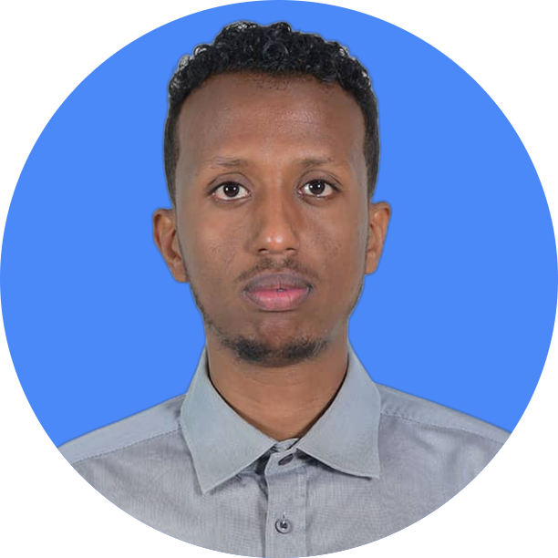
THANK YOU
Ismail Mohamed
(MSc In Computer Science) +251927802065
Haaji.dheere@gmail.com

